Slide 1
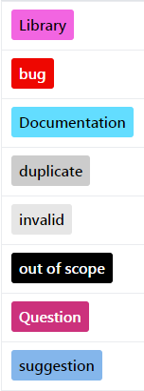

What’s the issue with?
Bug or feature request?
Resolution status

